Slide 1
Bing Ads Holiday Webinar

Slide 2
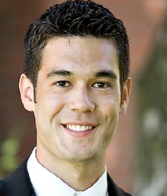
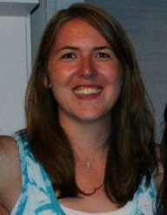
Welcome!
We hope this webinar helps you get more out of your search advertising campaigns this holiday season.
Lauren Taft-McPhee Marketing Communications Manager
John Gagnon Bing Advertising Evangelist

Slide 3
Table of contents
Industry trends
2011 Review
2012 Forecast
Optimization basics
Keywords
Ad Copy
Landing Pages
Opportunities
Mobile
Content Ads
Platform & Tools
Bing Ads
Bing Ads Intelligence
New Bing Ads features
Google Import
Broad Match Modifier
Ad Extensions
Resources
Questions

Slide 4
Holiday forecast and trends

Slide 5
Reach potential customers with the Yahoo! Bing Network
With one ad buy through Bing Ads, you can reach 151 million unique searchers using the Yahoo! Bing Network, which is 5.6 billion monthly searches and nearly one-third of the U.S. search share.¹
Unique Searchers
Searchers on Microsoft and Yahoo sites
are likely to spend 24% more than the average searchers, and likely to spend 5.4% more than Google searchers in the U.S.¹
Microsoft and Yahoo! unique searchers¹
151 Million
Percentage
Microsoft and Yahoo! unique searchers that don’t use Google¹
46 Million
1: comScore Core Search (custom), June 2012

Slide 6
A look at last year
Winter holidays is the No. 1 season for retail sales
US Retail eCommerce Sales, 2010-2016
2011: A record year
$361.9
$325.2
2011 marked a record year, with 46.63 billion in eCommerce Holiday Sales. (1)
Retail e-commerce spending for the November–December 2011 holiday season reached $37.2 billion. (2)
Spending marked a 15 percent increase over last year and an all-time record for the season. (2)
Ten individual shopping days, led by Cyber Monday, surpassed $1 billion in spending. (2)
$289.8
$256
$224.2
$167.3
$194.3
15.2%
16.1%
15.4%
14.2%
13.2%
12.2%
11.3%
Retail eCommerce sales
(in billions)
% change
Source: eMarketer, March 2012; confirmed and republished, Sep 2012
1: eMarketer: Savvy Shoppers Drive Robust Online Holiday Sales, Sept. 14, 2012
2: comScore Press Release, Jan. 4, 2012

Slide 7
The 2012 forecast
Online holiday sales will reach $54.5 billion in 2012, up 16.8% over 2011.
US Retail eCommerce Holiday Season Sales, 2007-2012
16.8%
Ecommerce sales for all of 2012 are on target to reach $224.2 billion, up 15.4% year over year.
$54.47
15.4%
$46.63
$40.04
$31.61
$33.79
$29
Brand 1
Brand 2
13%
Mobile shopping and online deal hunting will be major contributors to holiday ecommerce success.
Consumers will do more shopping earlier and later in the holiday season to take advantage of retail promotions. (1)
19.8%
-8.2%
16.5%
18.5%
16.5%
16.8%
140M
130M
125M
58%
Brand 3
19%
Retail eCommerce sales
(in billions)
% change
IBM
Source: eMarketer, Sep 2012
VMWare
Oracle
Cisco
Apple
1 eMarketer: What Retailers Can Expect in the 2012 Online Holiday Shopping
Other

Slide 8
Planning for 2012
When people plan to start holiday shopping, 2011
Source: Conducted for NRF by BIGresearch®, Consumer Intentions & Actions® Survey, 2011
SEPTEMBER
OCTOBER
NOVEMBER
DECEMBER
Review last year’s campaign.
Build out your keyword list.
Start testing ad copy.
Familiarize yourself with new Bing Ads features.
Check your account health.
Launch your holiday keyword list.
Create seasonal ad copy.
Monitor your competition.
Allocate additional budget.
Monitor your ads’ position and adjust your bids.
Prepare and launch specific ads for Black Friday and Cyber Monday.
Offer additional incentives and discounts.
Create urgency with updated ad copy.
After last ship date, drive traffic to brick-and-mortar stores.
Don’t forget that post-season sales continue after the holidays.

Slide 9
2012 peak dates
Weekend Online Holiday Retail Sales in Millions ($)
2012 key dates
Daily Holiday Shopping Milestones
Year-over-Year Comparison
11/23 Black Friday
11/26 Cyber Monday
12/03 Green Monday
12/18 Last Ship Date
12/27 Post Holiday Sales
+9%
+2%
+29%
+31%
0%
Peak Season
Source: comScore 2011
Source: comScore Press Release 1/4/2012

Slide 10
Optimization strategies

Slide 11
Optimizing for the holiday season The five pillars
Keywords
Ad Copy
Targeting
Budgeting
Reporting
Create holiday keyword list
Use competitive bids
Monitor position
Bid on all Match Types
Identify negative keywords
Solve editorial issues early
Test ad copy early
Create dynamic ad copy
Include pricing and incentives
Match your competitors’ offers
Adjust during season: Target early-bird and last-minute shoppers
Pause the under-performing ads
Separate mobile and content ads from search ads
Use incremental bidding to reach your demographic audience
Physical stores can use radius targeting
Separate search, content, and mobile campaigns for easier adjustment
Define your goals
Plan for growth
Increase budget each month
Prepare for peak days
Monitor your campaigns
Run regular reports

Slide 12
Optimizing for the holiday season Keywords
Generic Keywords
Specific Keywords
Holiday Gift Jewelry Necklace Gold Necklace 14 k gold necklace 14 karat white gold necklace
Keywords
Ad Copy
Targeting
Budgeting
Reporting
Keyword list should include head and long-tail terms with seasonal expansion.
Undecided Searcher/Buying Intent Very Decided
Try to catch both undecided and very decided shoppers.
High Traffic Low
Find the balance between high traffic and high CTR.
Low CTR High
Keywords

Slide 13
Optimizing for the holiday season Match types
Jewelry Terms – Match Type Summary
300,000
3,500
250,000
3,000
200,000
2,500
150,000
2,000
1,500
100,000
1,000
Best Practice:
Bid on all match types!
50,000
500
0
Broad
Exact
Phrase
0
Impressions
Clicks
Jewelry Terms – Match Type CTR
Jewelry Terms – Match Type CPC
2.00%
$1.20
1.80%
$1.00
1.60%
1.40%
$0.80
1.20%
Broad
Broad
1.00%
Exact
$0.60
Exact
0.80%
Phrase
$0.40
Phrase
0.60%
0.40%
$0.20
0.20%
0.00%
CPC
$0.00
CTR
Keywords
Keywords
Ad Copy
Targeting
Budgeting
Reporting
Source: Bing Ads data

Slide 14
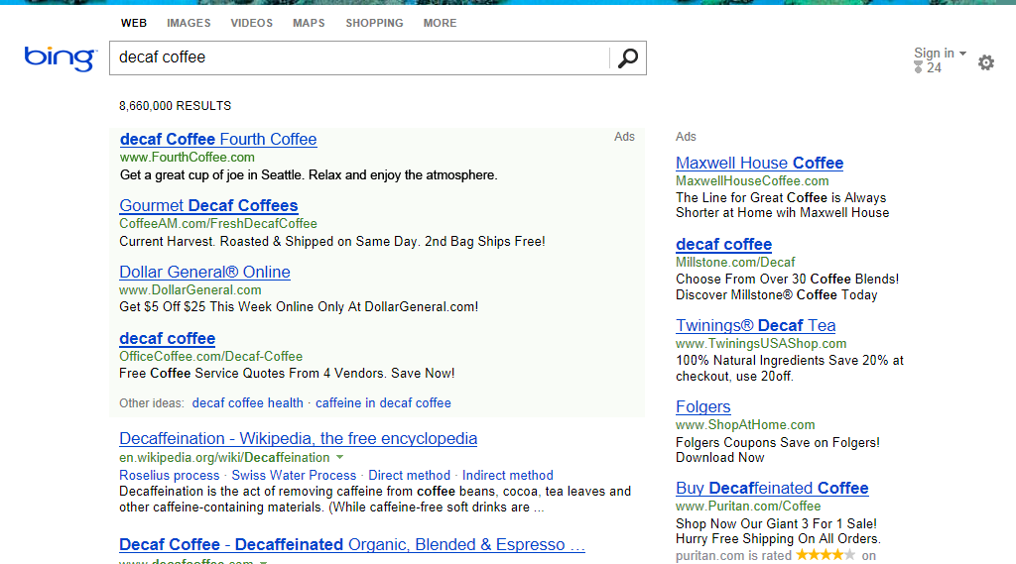
Optimizing for the holiday season Positioning
Bid for top positions
Click volume declines below position 3, and 60% of all clicks come from positions 1-3.
Average CPC is lower than the maximum bid, especially in position 1.
When below position 4, CTR drops significantly leading to less traffic.
Jewelry Terms – Max Bid CPC and avg. CPC
Jewelry Terms – Click Volume
30.00%
$2.50
25.00%
$2.00
20.00%
$1.50
15.00%
$1.00
Mainline (ML) (positions 1-4)
10.00%
$0.50
5.00%
$0.00
Sidebar (SB) (positions 1-10)
0.00%
1
1
2
2
3
3
4
4
5
5
6
6
7
7
8
8
Natural/Organic
Max Bid CPC
Avg Bid CPC
Keywords
Keywords
Ad Copy
Targeting
Budgeting
Reporting
Source: Bing Ads data

Slide 15
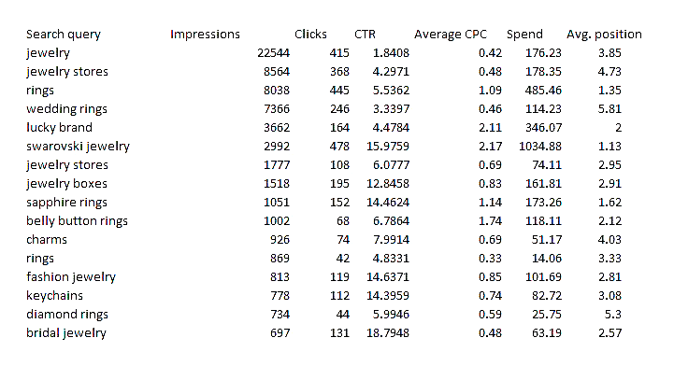
Optimizing for the holiday season Negative Keyword
Negative keywords help increase relevance and CTR.
Add negatives on the campaign, ad group, or keyword level.
Use the Search Query Performance report to see what customers are searching for:
Identify negative keywords, such as products you don’t offer. Example: “belly button rings.”
Belly button rings
Or identify keywords missing from your account. Example: “bridal jewelry.”
Bridal jewelry
Keywords
Keywords
Ad Copy
Targeting
Budgeting
Reporting

Slide 16
Optimizing for the holiday season Ad copy
Test early.
Run multiple ads.
Tailor to the season.
Increase incentives.
Create urgency.
Speak to consumer priorities, increase relevancy.
Sideline ad:
Gifts for the Holidays
www.TailSpinToys.com
All Toys On Sale. Order Now and Save 40%
Mainline ad:
Gifts for the Holidays – All Toys On Sale
www.TailSpinToys.com
All Toys On Sale. Order Now and Save 40%
Keywords
Ad Copy
Ad Copy
Targeting
Budgeting
Reporting

Slide 17
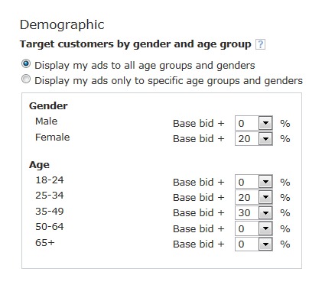
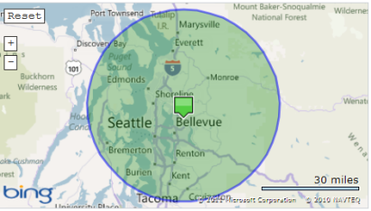
Optimizing for the holiday season Targeting
The better you know your customers, the more you can target them. Bing Ads lets you use exclusive targeting or incremental bidding. This means if a searcher is female, you can automatically raise your bid by a percentage you specify. You can also target by age group and location.
Target options
Location
Device
Day of week
Time of day
Gender
Age
Radius targeting allows you to target searchers located within 5–100 miles of your business address to increase your campaign CTR and ROI.
By combining multiple targets, small businesses can effectively compete against nationwide retailers.
Keywords
Ad Copy
Targeting
Targeting
Budgeting
Reporting

Slide 18
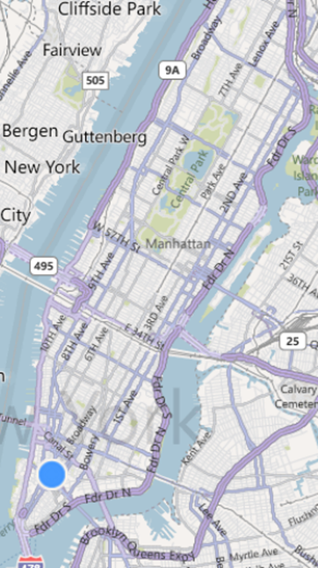
Optimizing for the holiday season Targeting
Central Park
Drop off your customers at the right place
Every additional click to get to the checkout page causes drop-offs from your website!
Create individual ad groups for product groups (i.e., rings, watches, jewelry).
Use the home page only for brand and generic terms. Link specific queries to the page where the product can be bought.
Wall Street
Example:
Board Games www.TailSpinToys.com
All Toys On Sale. Order Now and Save 40%
Board Games Landing Page
board games
Keywords
Ad Copy
Targeting
Targeting
Budgeting
Reporting

Slide 19
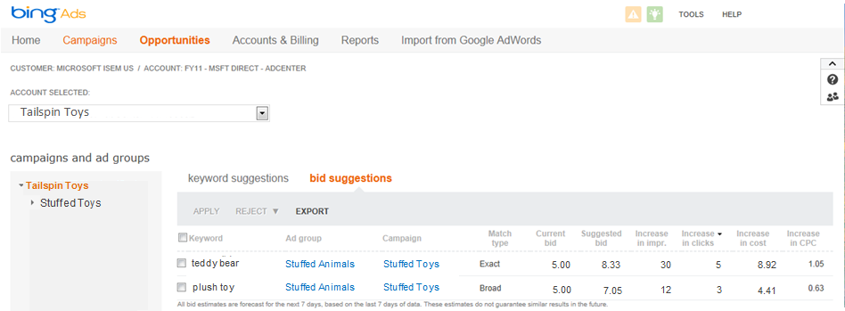
Optimizing for the holiday season Budgeting
Budgeting
Define your goals ROI & Conversions
Plan for growth As competition heats up, have enough budget left for peak dates.
Adjust during the season Stay competitive with your bids.
Compare search engines Move budget between engines depending on performance.
Keywords
Ad Copy
Targeting
Budgeting
Budgeting
Reporting
Reporting

Slide 20
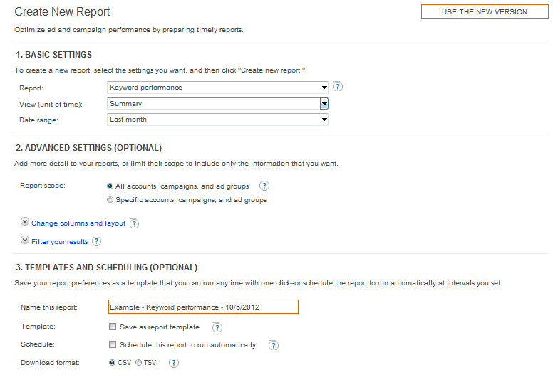
Optimizing for the holiday season Reporting
Reporting
Monitor your campaigns
Use keyword and ad copy reports to check performance and optimize for CTR, costs, and position.
Find new keywords
Use search query performance reports to identify what consumers are looking for.
Save time
Schedule your reports and have them sent to your inbox.
Keywords
Ad Copy
Targeting
Budgeting
Budgeting
Reporting
Reporting

Slide 21
Opportunities

Slide 22
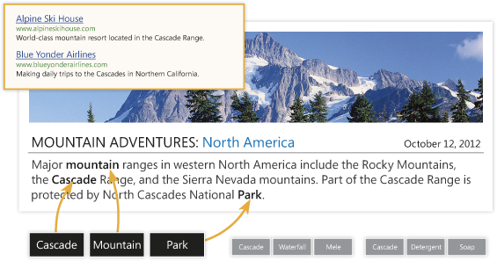
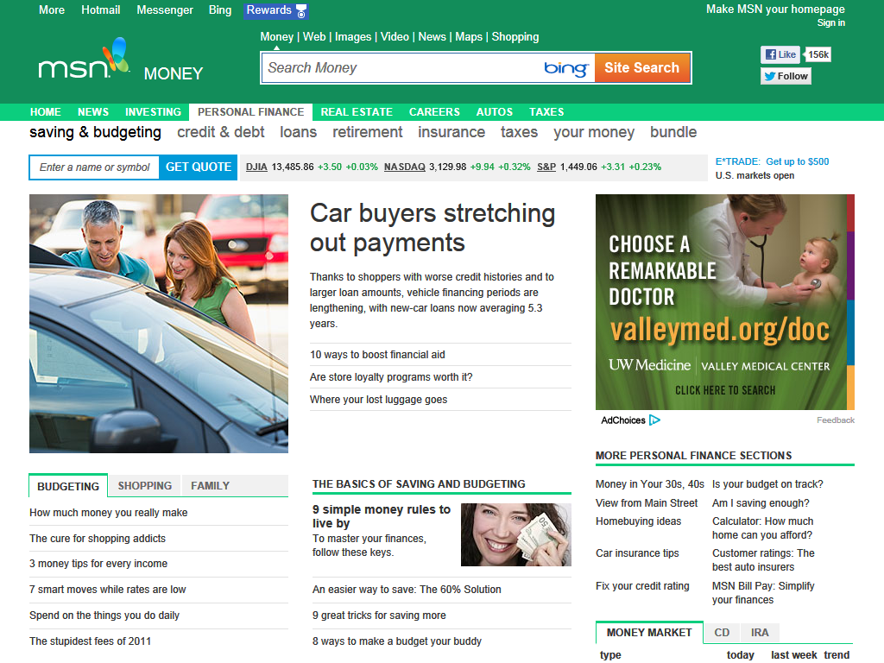
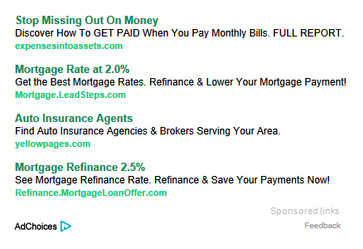
Optimizing for the holiday season Content ads
The four keys to success with content ads:
Create a dedicated content ads campaign.
Choose content keywords and ad copy.
Place competitive bids.
Test, track, and refresh.

Slide 23
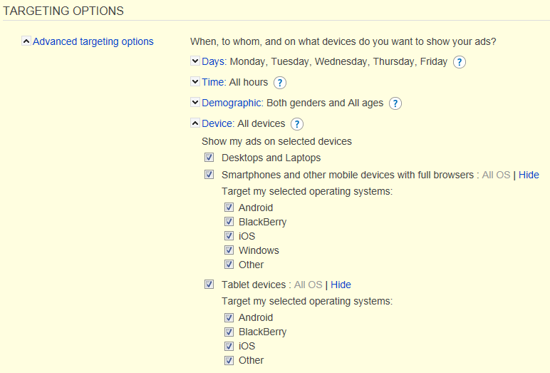
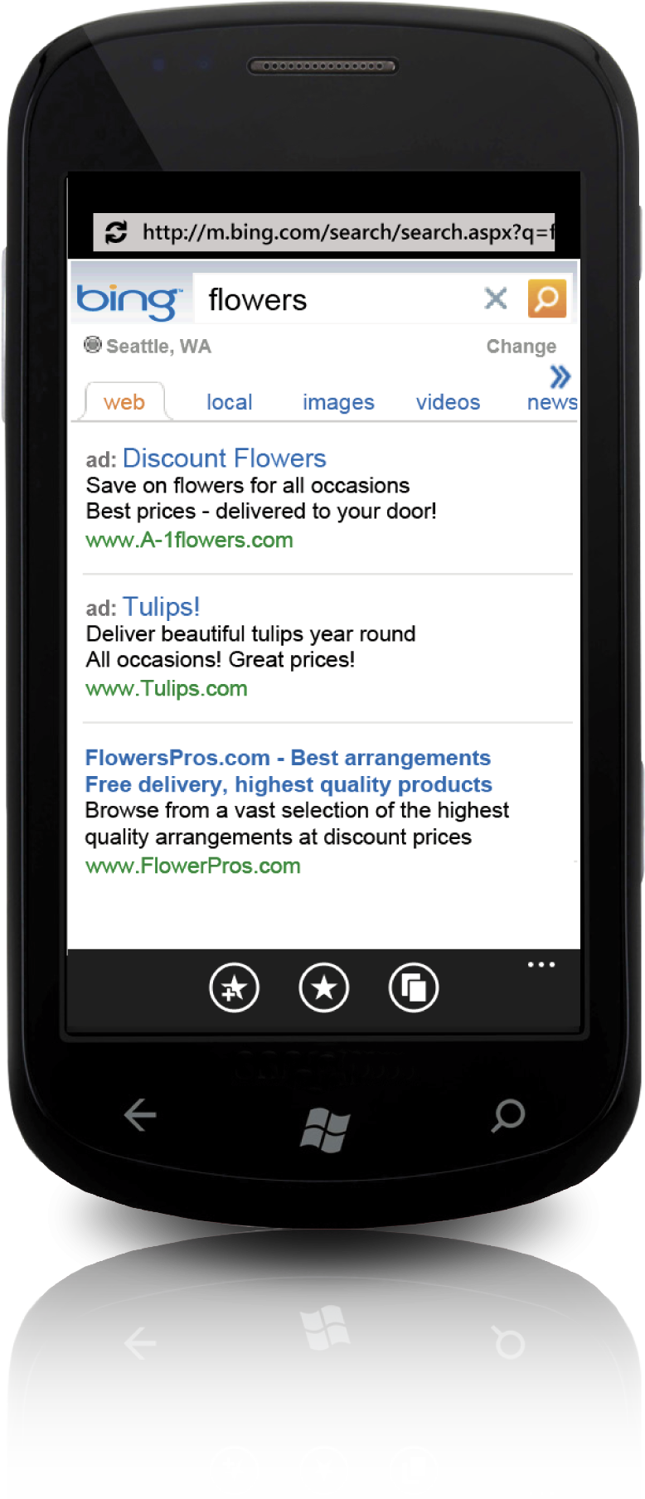
Optimizing for the holiday season Mobile ads
In December 2011, mobile shoppers contributed 14.6% of traffic and 11.0% of sales on retail sites. (1)
IBM predicts that by December 2012 mobile sales will double and exceed 20% of site sales. (1)
Use Bing Ads rich mobile targeting options for mobile success this year.
Percentage of Total eCommerce Dollars Spent via Mobile or Tablet Device
Spike in percentage of eCommerce sales via mobile coincides with surge in tablet ownership
Source: comScore Mobile Measurements
1 eMarketer: What Retailers Can Expect in the 2012 Online Holiday Shopping Season; September 2012

Slide 24
Platform & Tools

Slide 25
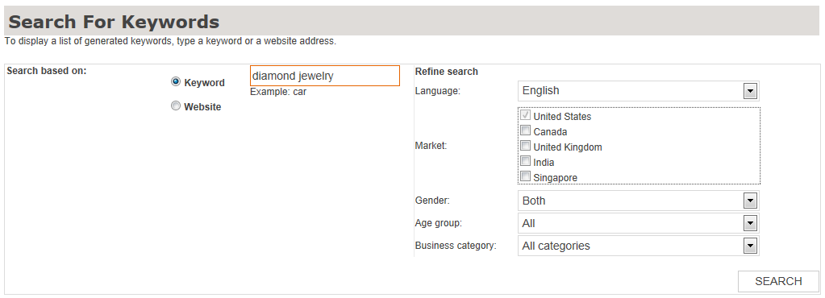
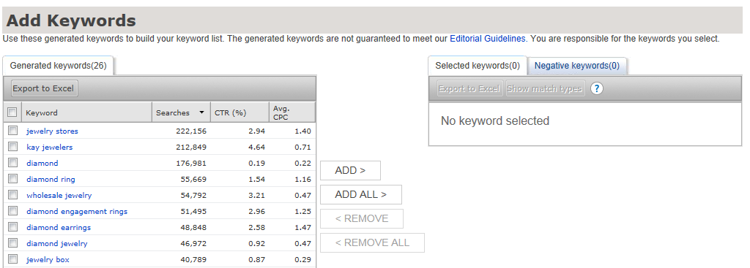
Helpful tools Generating keywords in Bing Ads
In the tools menu, locate the Research Keywords option, then search by keyword or website.

Slide 26
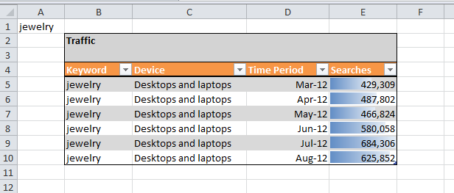
Helpful tools Bing Ads Intelligence – Generating keywords
Bing Ads Intelligence is an Excel add-in that can be downloaded from the Bing Ads tools section.
Providing advanced insights for Bing Ads across all accounts
Traffic volume and historical trends for keywords
Average costs and click-through rates for keywords
Demographics information on keywords
Expanded keyword and negative keyword suggestions
Bing Ads Intelligence

Slide 27
New Bing Ads features

Slide 28
New Bing Ads features
Import Campaigns^{Beta}
Location extensions
Broad match modifier
Sitelink extensions

Slide 29
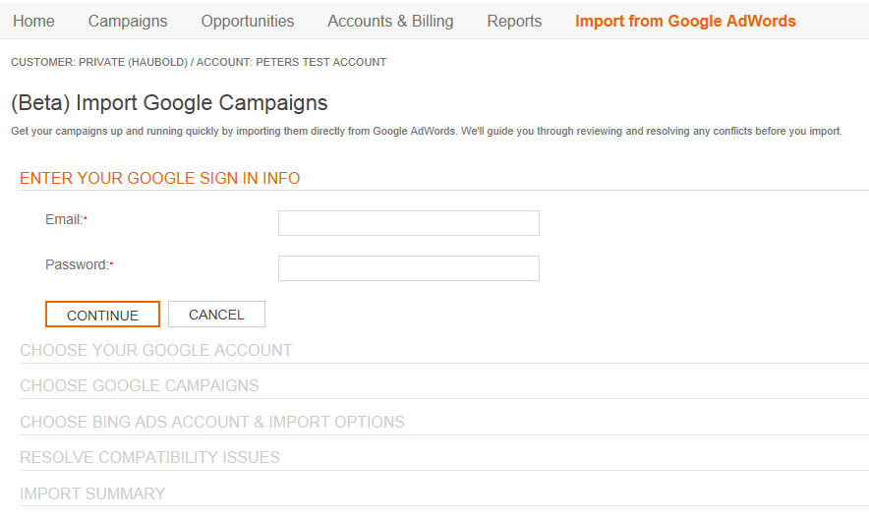
New Bing Ads features Import Campaigns^{Beta}
Import Campaigns^{Beta}
With the Import Campaigns feature, you only need to optimize once. Just import the changes you made in your Google campaigns over to Bing Ads.
Resource
Learn more

Slide 30
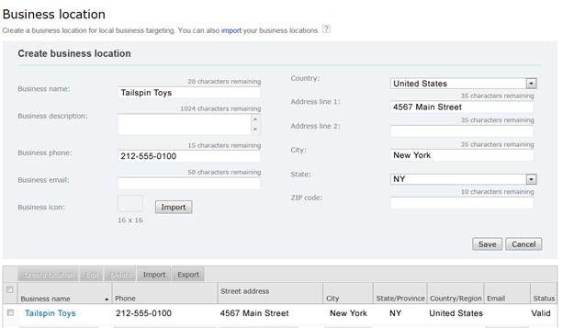
New Bing Ads features Location Extensions
Location Extensions
Using Location Extensions, you can display your business address and phone number in your text ad. That can help drive leads and bring more customers to your door.
Resource
Learn more
A recent Microsoft Advertising study of 850 advertisers in the United States found that campaigns using Location Extensions had click-through rates 8 to 16 percent higher than campaigns without Location Extensions.¹
1: Internal adCenter data, SMB and premium advertisers, November 2011 through January 2012

Slide 31
New Bing Ads features Broad Match Modifier
Broad Match Modifier
Broad Match Modifier helps to make your broad match delivery more predictable. Adding a plus sign in front of a keyword means that a term must be present in the query for it to trigger your ad.
Bidded KWs | Queries served
Geico Insurance | Geico car insurance Progressive insurance
Lipitor disease | Lipitor heart disease Heart disease
Hawaii hotels | Hawaii beach hotels Hawaii rentals
Bidded KWs | Queries served
+Geico Insurance | Geico car insurance Progressive insurance
+Lipitor disease | Lipitor heart disease Heart disease
+Hawaii +hotels | Hawaii beach hotels Hawaii rentals
With BMM
Resource
Learn more

Slide 32
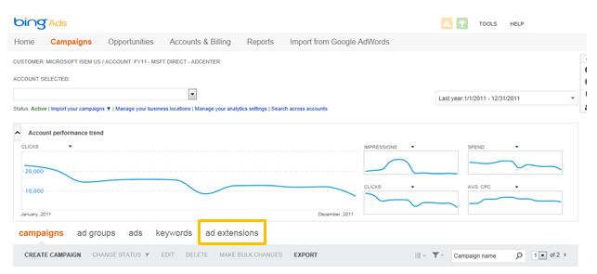
New Bing Ads features Sitelink extensions
Sitelink extensions are additional links in your ads that take searchers to specific pages on your website, helping you drive deeper engagement with your potential customers
Resource
Learn more

Slide 33
Summary and resources

Slide 34
Optimizing for the holiday season Summary
Keywords
Identify and invest in your most successful keywords.
Ad copy
Create seasonal ads and offer incentives; free shipping is expected.
Targeting
Combine targets (geo and demo) to reach your ideal audience.
Plan for growth and be prepared for peak seasonal dates.
Budgeting
Reporting
Monitor your campaigns and make informed decisions.

Slide 35
Tools and resources
Download the Bing Ads Intelligence Tool: Find it in the Bing Ads Tools section.
Visit our Vertical Insights page: Stay on top of seasonal trends specific to your business.
Get expert advice: Read the Bing Business blog for the latest updates and optimization techniques.
Read your Bing Ads Newsletter: Get new tips and tricks from us every month.
Need help? Phone Support: 1-800-518-5689

Slide 36
Questions

Slide 37
Thank you for your participation!
Thank you for your participation!

